Slide 1

Introduction to Software Business Product management
Week 1 Day 2
Led by: Emily Crose
for
Oakland University

Slide 2

Week 1 recap

Slide 3

Questions From Last Week?

Slide 4
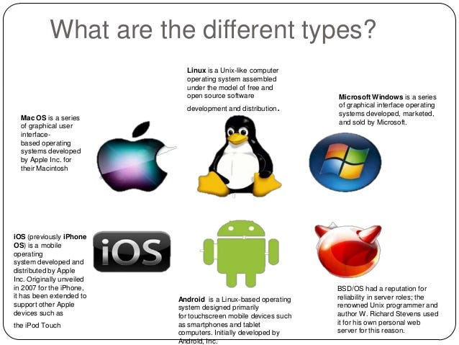
Operating systems

Slide 5
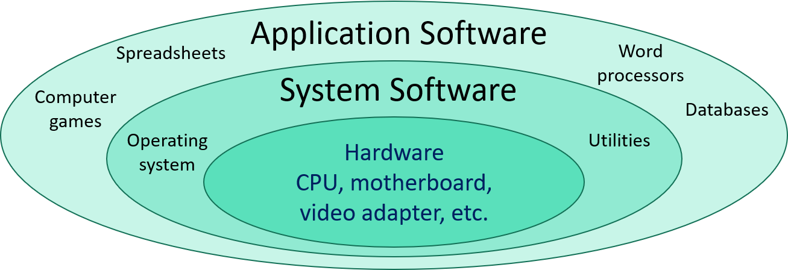
Operating Systems vs Applications
Notes:
What about you all? Where do you come from? What kinds of backgrounds do you have?

Slide 6
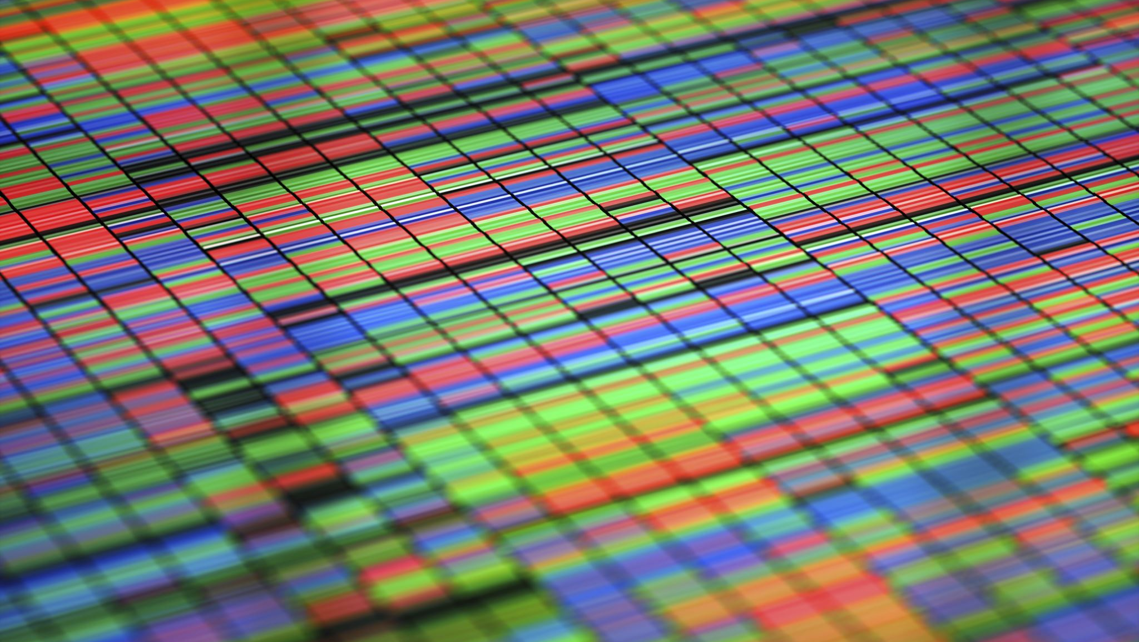
Applications

Slide 7
Types of Applications
Mobile applications
Desktop applications
Embedded applications
Web applications

Slide 8
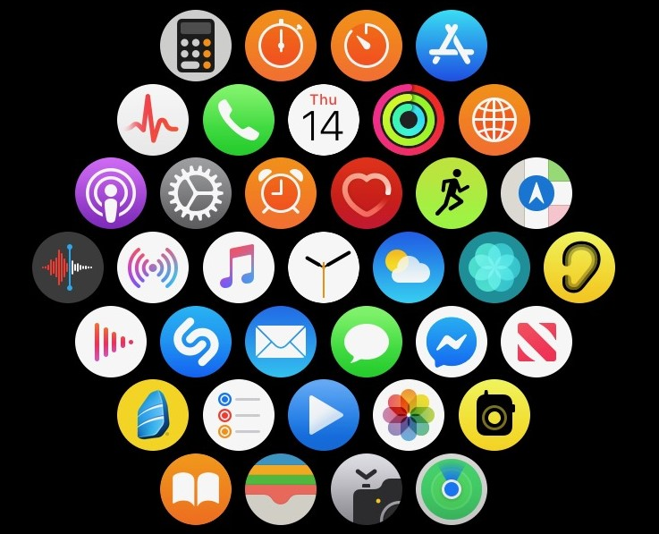
Mobile Applications

Slide 9
Desktop Applications

Slide 10
Web Applications

Slide 11
Embedded Applications

Slide 12
“thin” client vs “thick” client
Notes:
There are also applications that serve to give access to

Slide 13
CPU Architecture

Slide 14
The software development life cycle
Notes:
Over the last couple of days, we’ve talked a lot about the types of software we may interact with in our lives. We now have a sense of scale of how large of a project it is to build an app, so the question for us becomes; how do we approach this project with as much organization as possible? That’s where the software development life cycle comes into play

Slide 15
Data security & Encryption

Slide 16
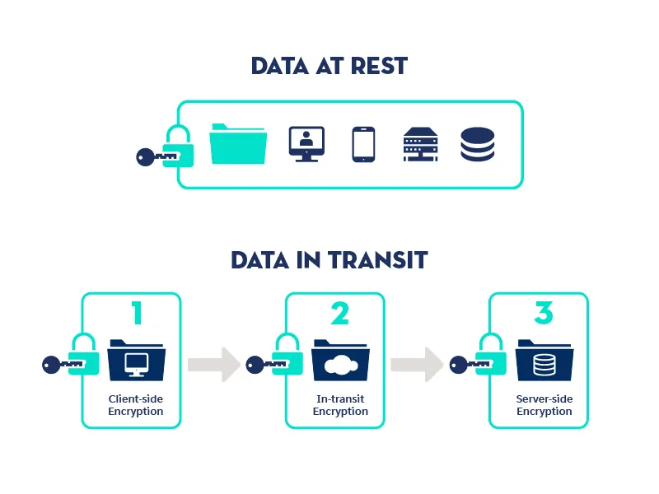
Securing Data

Slide 17
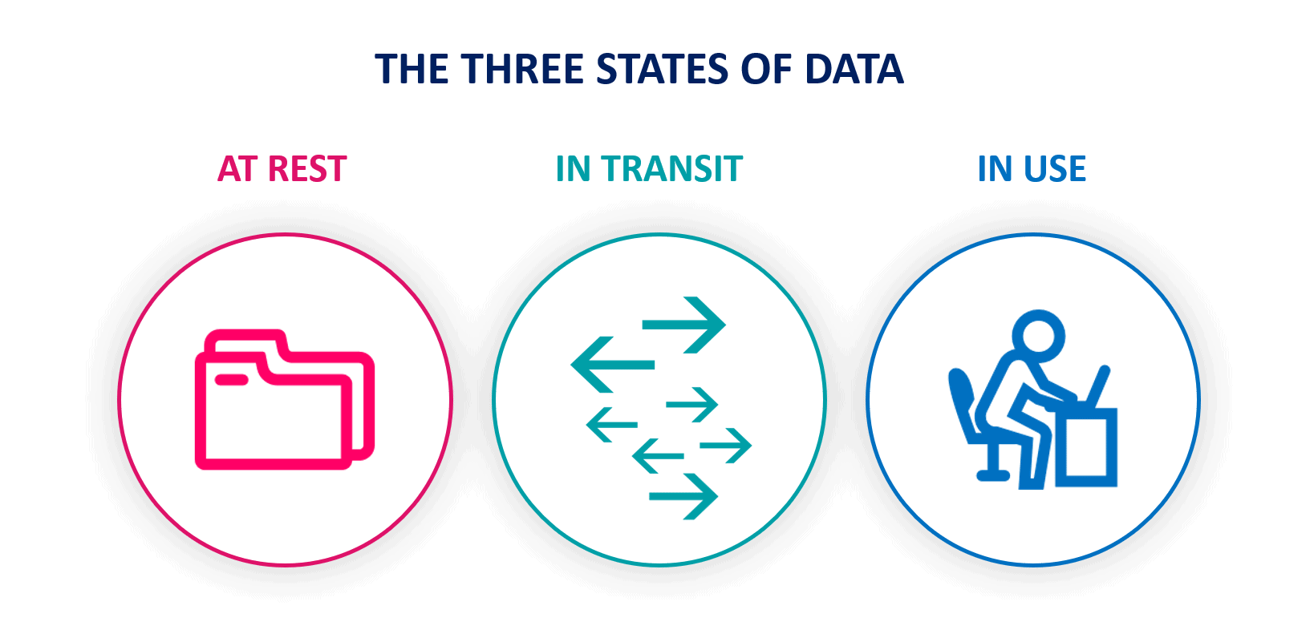
States Of Data

Slide 18
Application Programming Interfaces (APIs)
What do they do for applications?
How do they work?

Slide 19
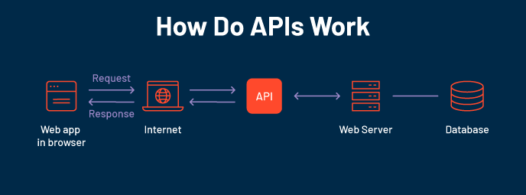

Slide 20
What is the Software Development Life Cycle?
The SDLC helps us organize the process of building software
Includes steps for building, revising, and deploying software
Includes roles associated with each step along the building process

Slide 21
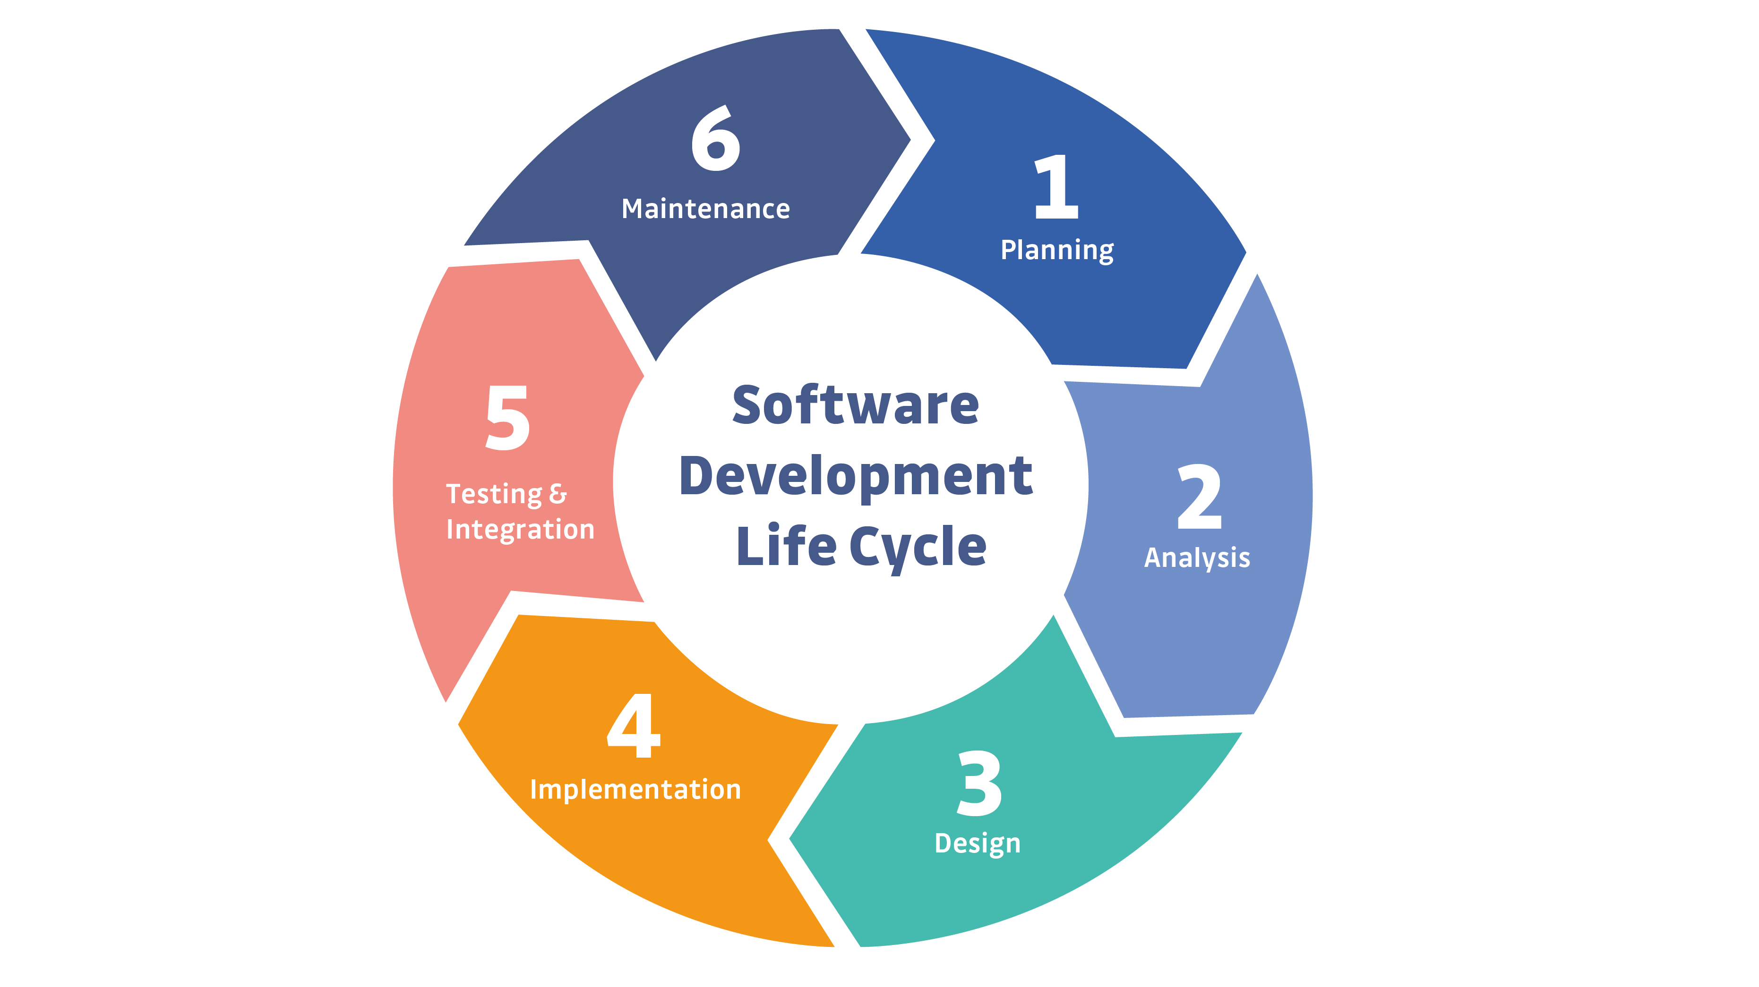
Notes:
This is a simple example of the SDLC. Typically, representations of the SDLC will have around 6 steps, but the steps will generally match what you see here.

Slide 22

Question or clarifications?

Slide 23

Questions?

Slide 24

Review Day 2

Slide 25

Preview day 3

